Slide 1
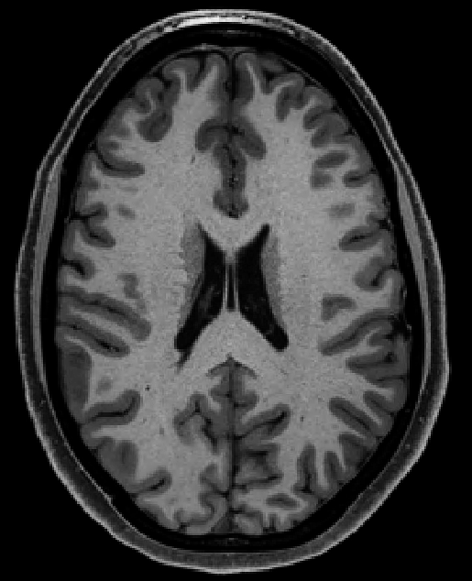

lateral ventricle (CSF)
subcortex
(WM)
sulcus
gyrus
cortex
(GM)
CSF
subcortical GM structures
cranium

Slide 2
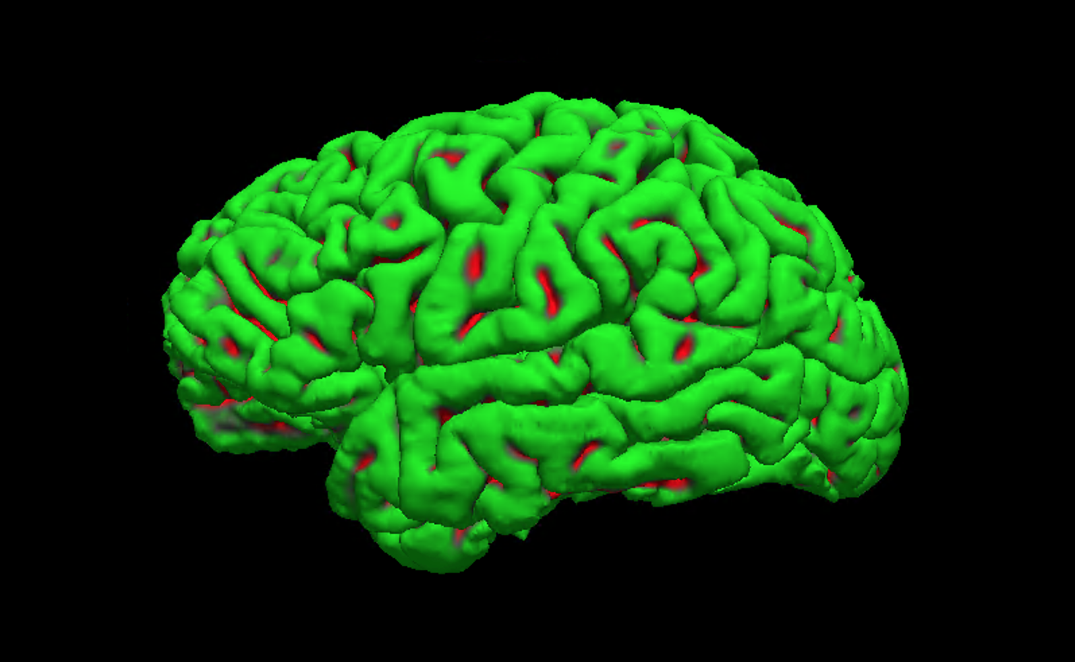
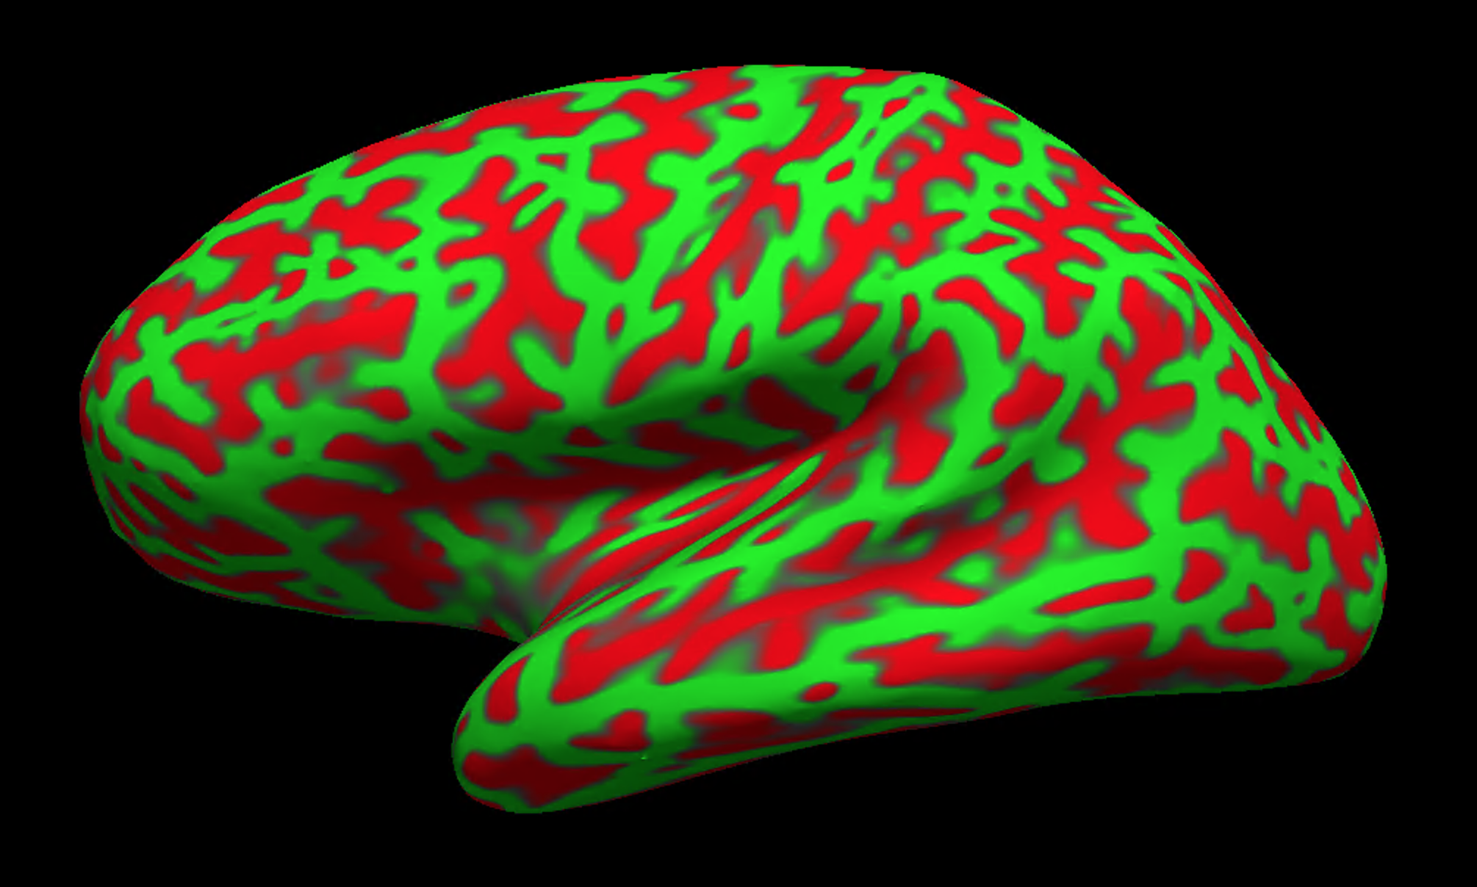
sulcus
gyrus
pial, native
pial, inflated

Slide 3
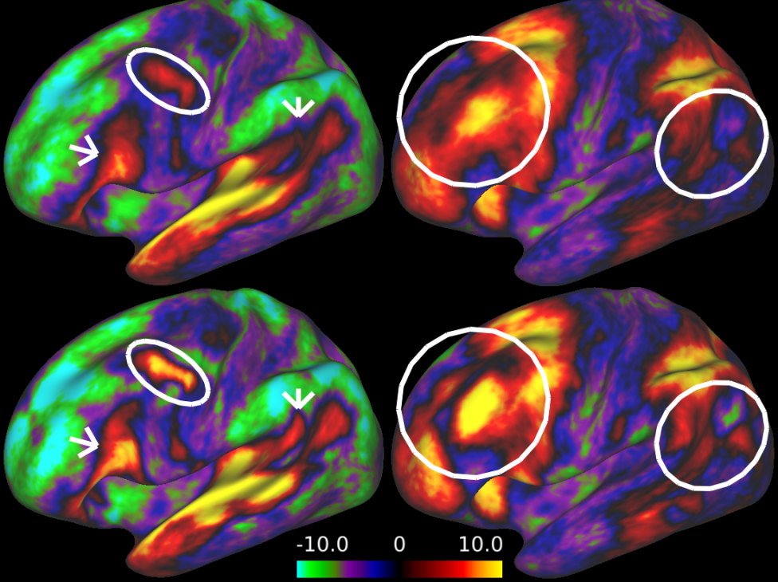
task A
task B
folding
folding + areal

